Slide 1

Biological surveys and monitoring
gbif.org/sam
Notes:
Notes

Slide 2

Biological surveys and monitoring
By integrating and standardizing systematically collected data about the presence, absence and abundance of species over time, GBIF provides an essential reusable resource for understanding and evaluating changes to life on Earth
gbif.org/sam
Notes:
Notes

Slide 3
Biological surveys and monitoring
Our planet's biodiversity faces unprecedented pressures, making biological surveys and monitoring efforts more essential than ever. Whether driven by scientific inquiry, conservation needs, national and corporate reporting, or natural curiosity, the systematic collection data about the presence, absence and abundance of species over time is indispensable for assessing biodiversity patterns and processes, informing science, policy and action, and understanding how organisms, assemblages and ecosystems respond to change.
In response to growing global demand, the GBIF network and its robust infrastructure enable researchers and institutions to share and and discover high-quality standardized ecological data that is free, open and FAIR. The widely adopted Darwin Core standard and its extensions—most notably the Humboldt extension for ecological inventories—ensures that users have access to essential data on survey design, sampling effort, scope, and methods, enabling them to assess datasets' relevance and reliability and base their analyses on a more complete view of global biodiversity.
gbif.org/sam

Slide 4
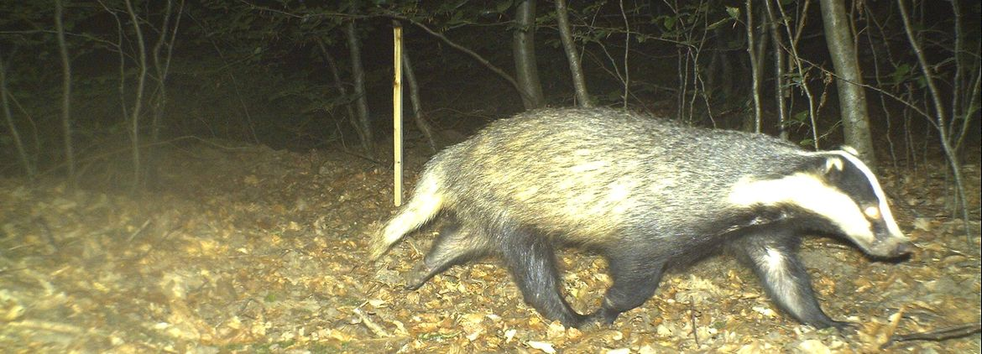


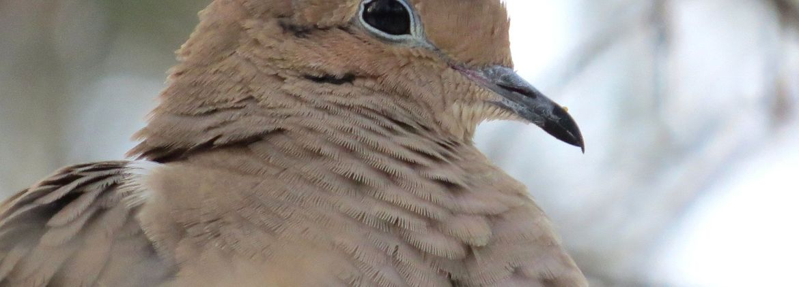
Featured data uses about survey and monitoring data
Camera trapping using machine learning: cheap wildlife monitoring for all
Risks and rewards: using citizen science for threatened species monitoring
Assessing impact of stressors on global penguin hotspots
Citizen science and global biodiversity monitoring
gbif.org/business
Notes:
Notes

Slide 5


Guides
Guide for publishing biological survey data to GBIF
Survey and Monitoring Data Quick-Start Guide
gbif.org/sam

Slide 6



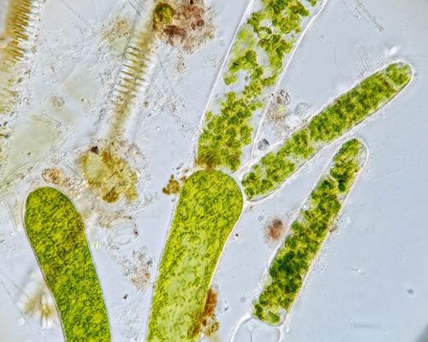
Featured datasets about survey and monitoring data
Circumpolar Seabird Monitoring Plan
UK Butterfly Monitoring Scheme (UKBMS)
Norwegian breeding bird monitoring scheme
SHARK - Regional marine environmental monitoring and monitoring projects of Epibenthos in Sweden since 1994
gbif.org/sam
Notes:
Notes

Slide 7

Featured publishers of survey and monitoring data
Cornell Lab of Ornithology
MGnify
CSIRO National Collections and Marine Infrastructure (NCMI) Information and Data Centre (IDC)
Instituto de Investigación de Recursos Biológicos Alexander von Humboldt
gbif.org/sam
Notes:
Notes

Slide 8



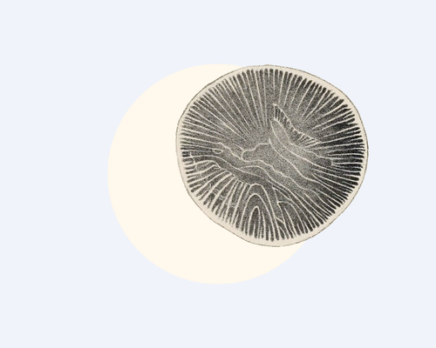

Community resources
GitHub
Mailing list
Quarterly zoom meeting
Powerpoint slides about GBIF and SAM
Use cases
gbif.org/sam

Slide 9
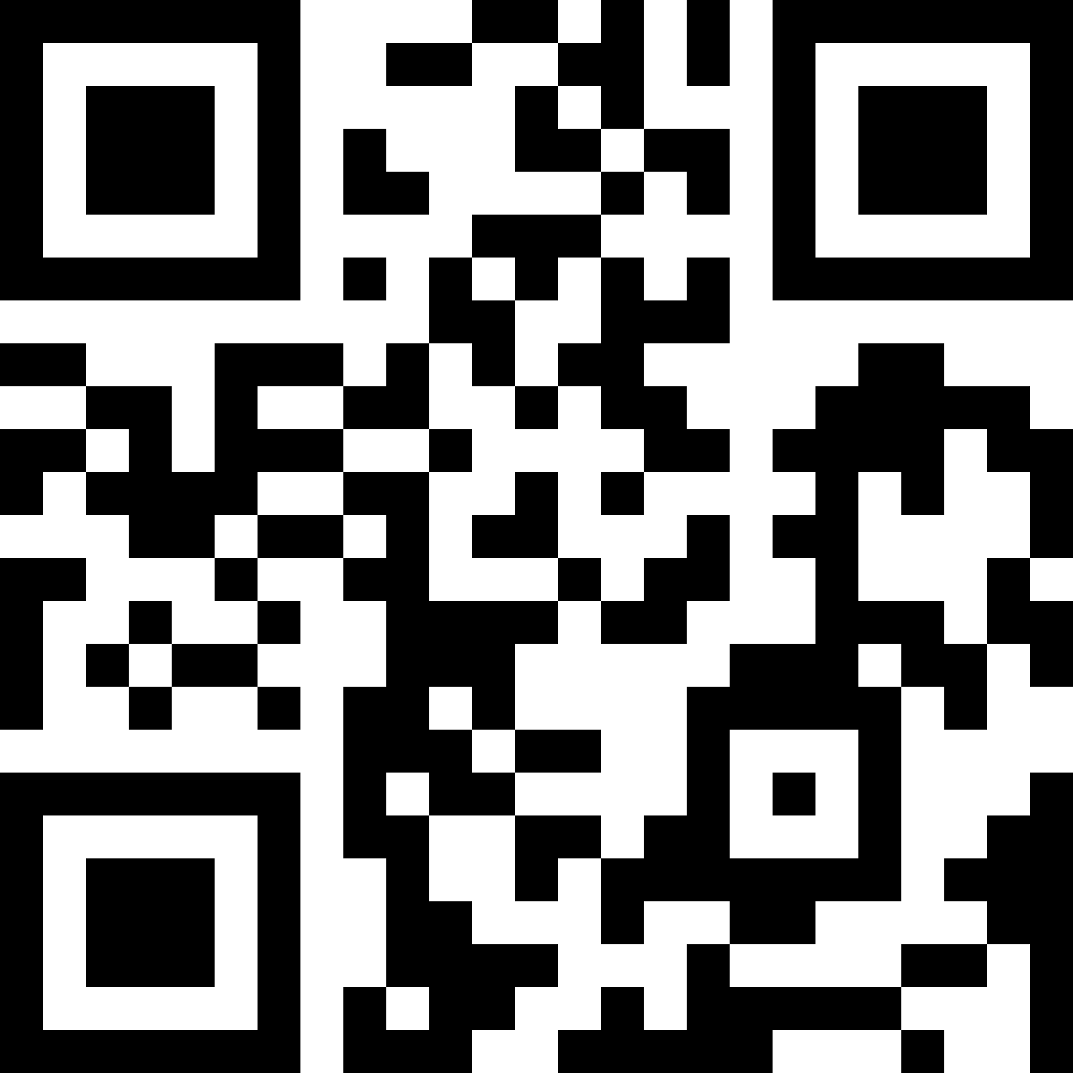
Biological surveys and monitoring
Learn more!
gbif.org/sam

